Slide 1
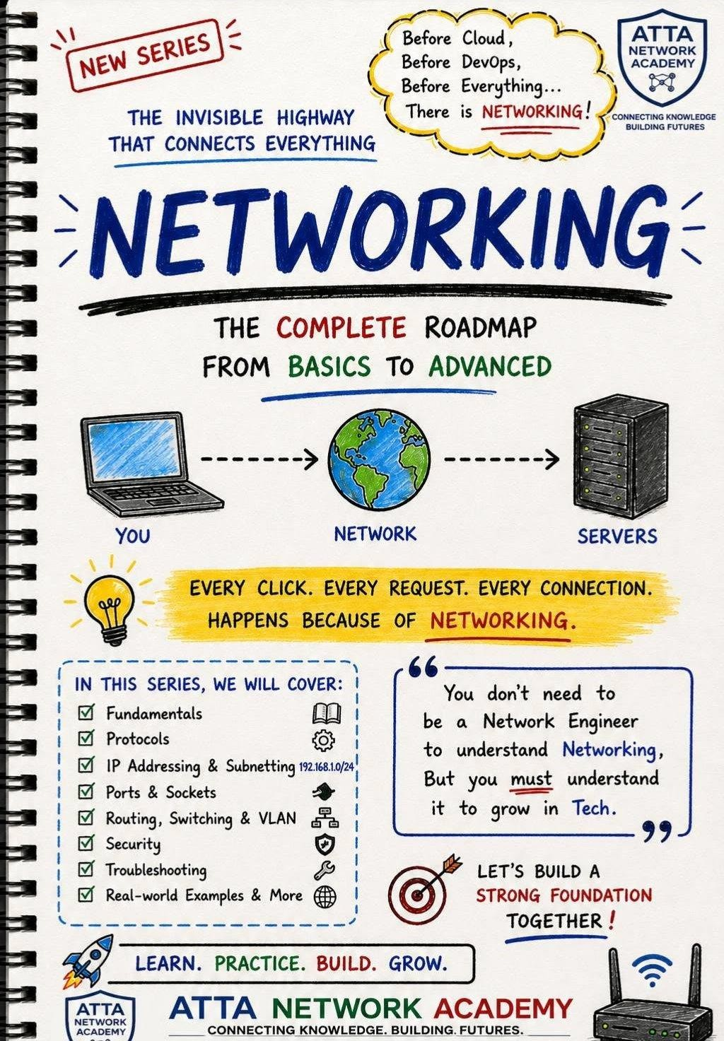
Networking & Connected Technologies

Slide 2
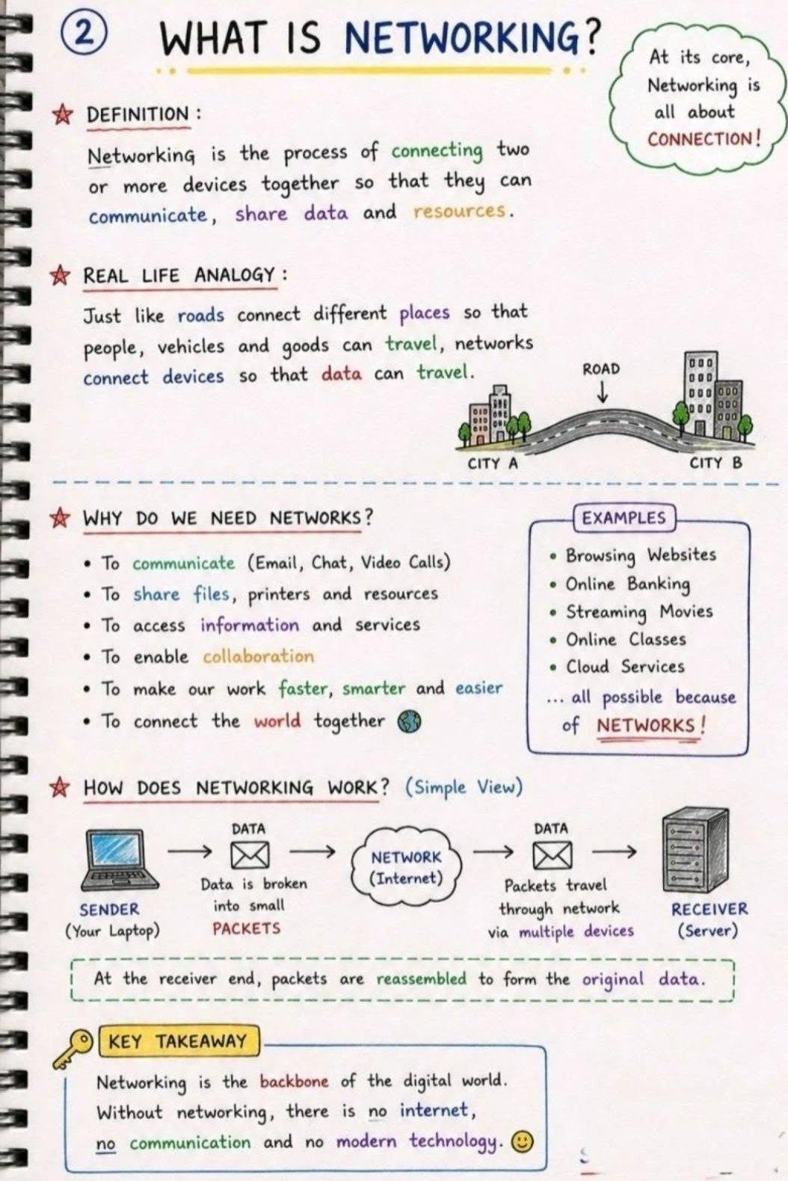
Networking & Connected Technologies

Slide 3
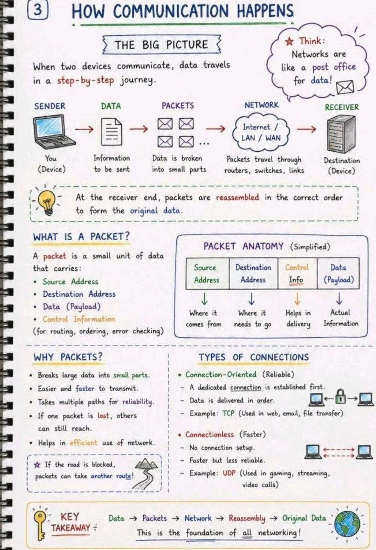
Networking & Connected Technologies

Slide 4
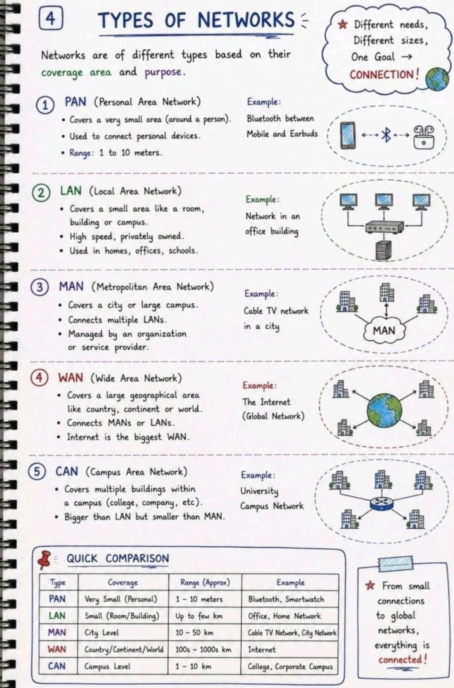
Networking & Connected Technologies

Slide 5
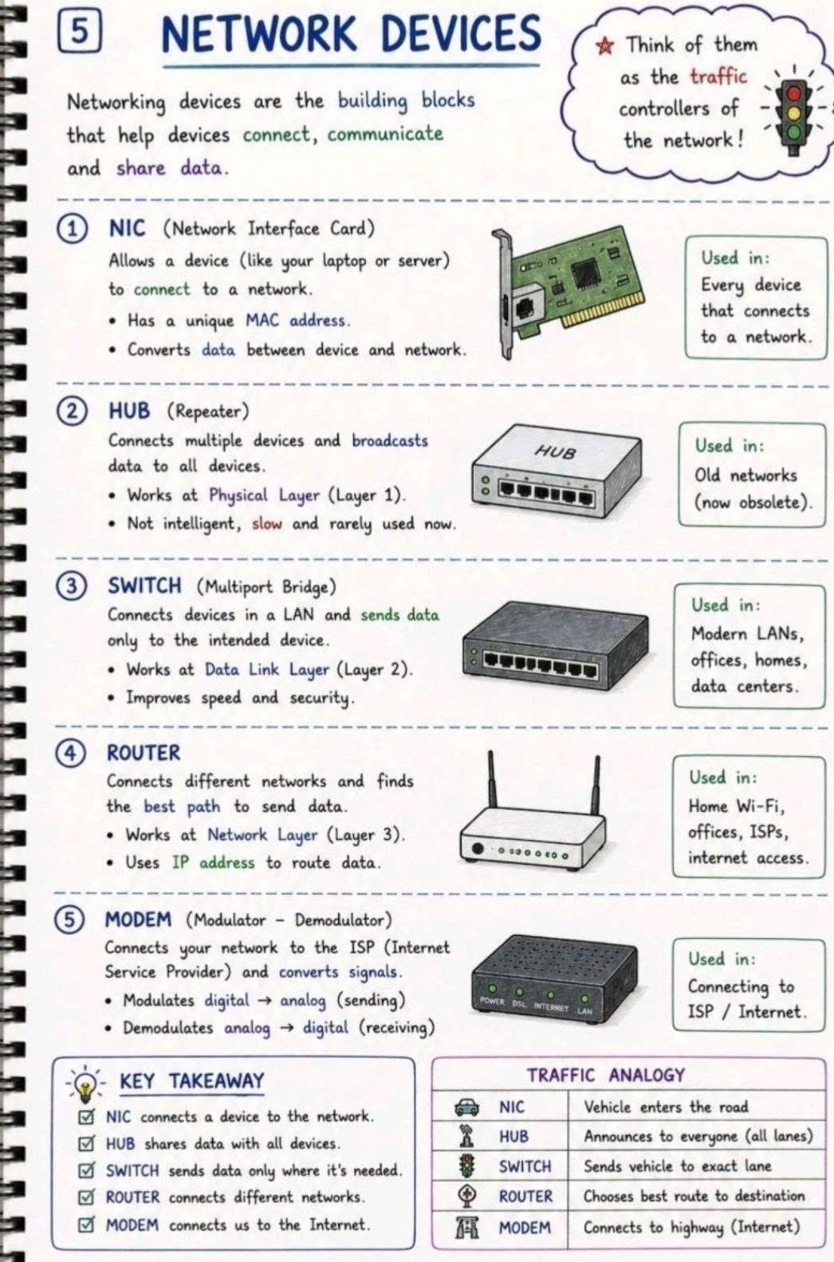
Networking & Connected Technologies

Slide 6
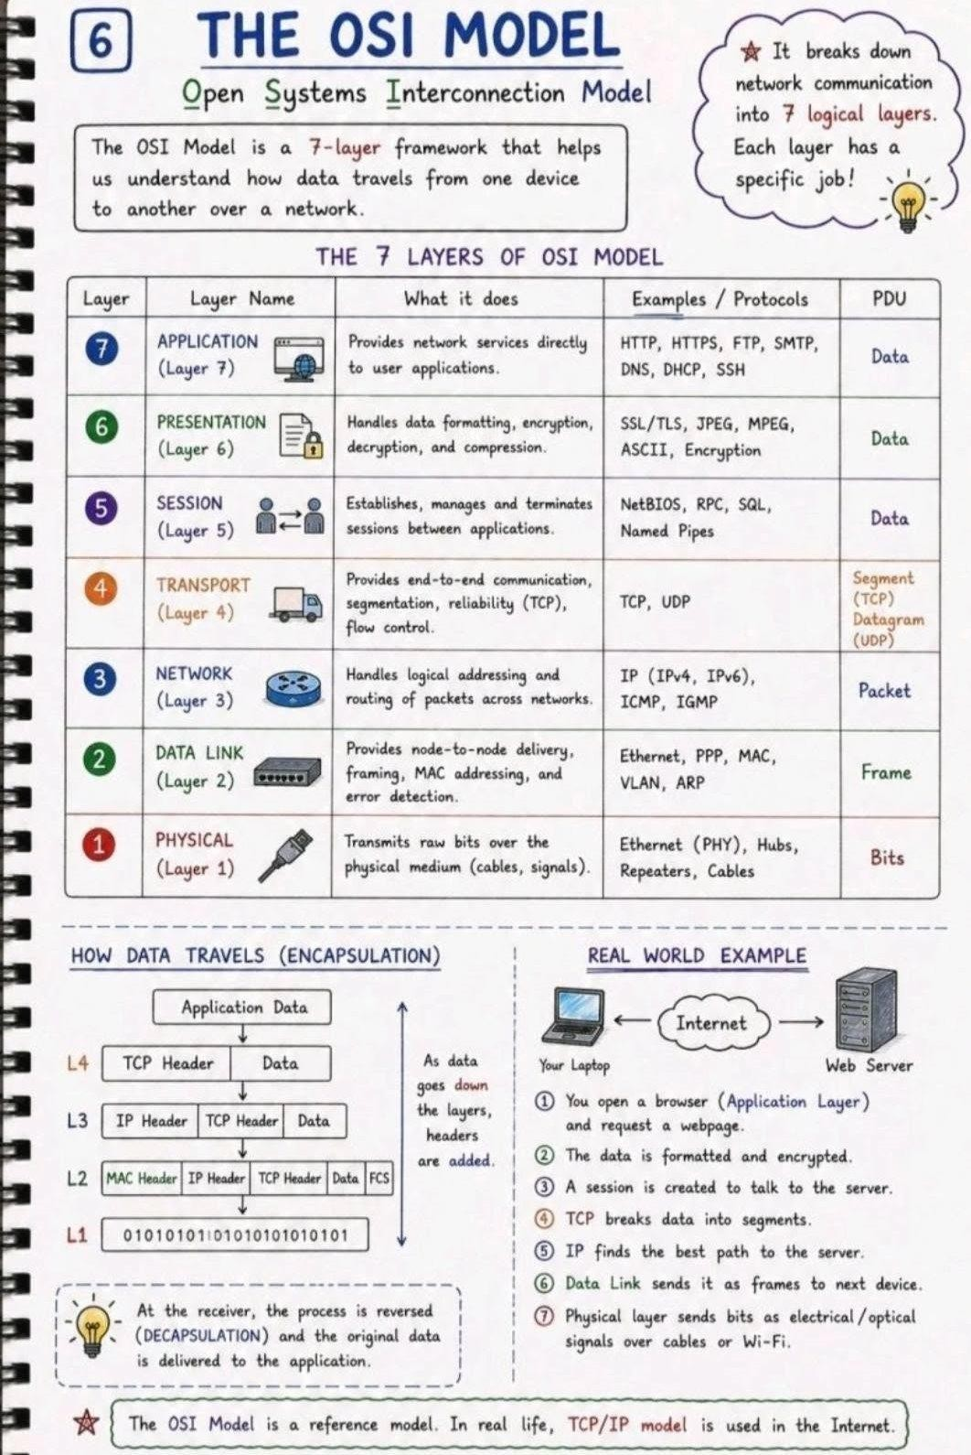
Networking & Connected Technologies

Slide 7
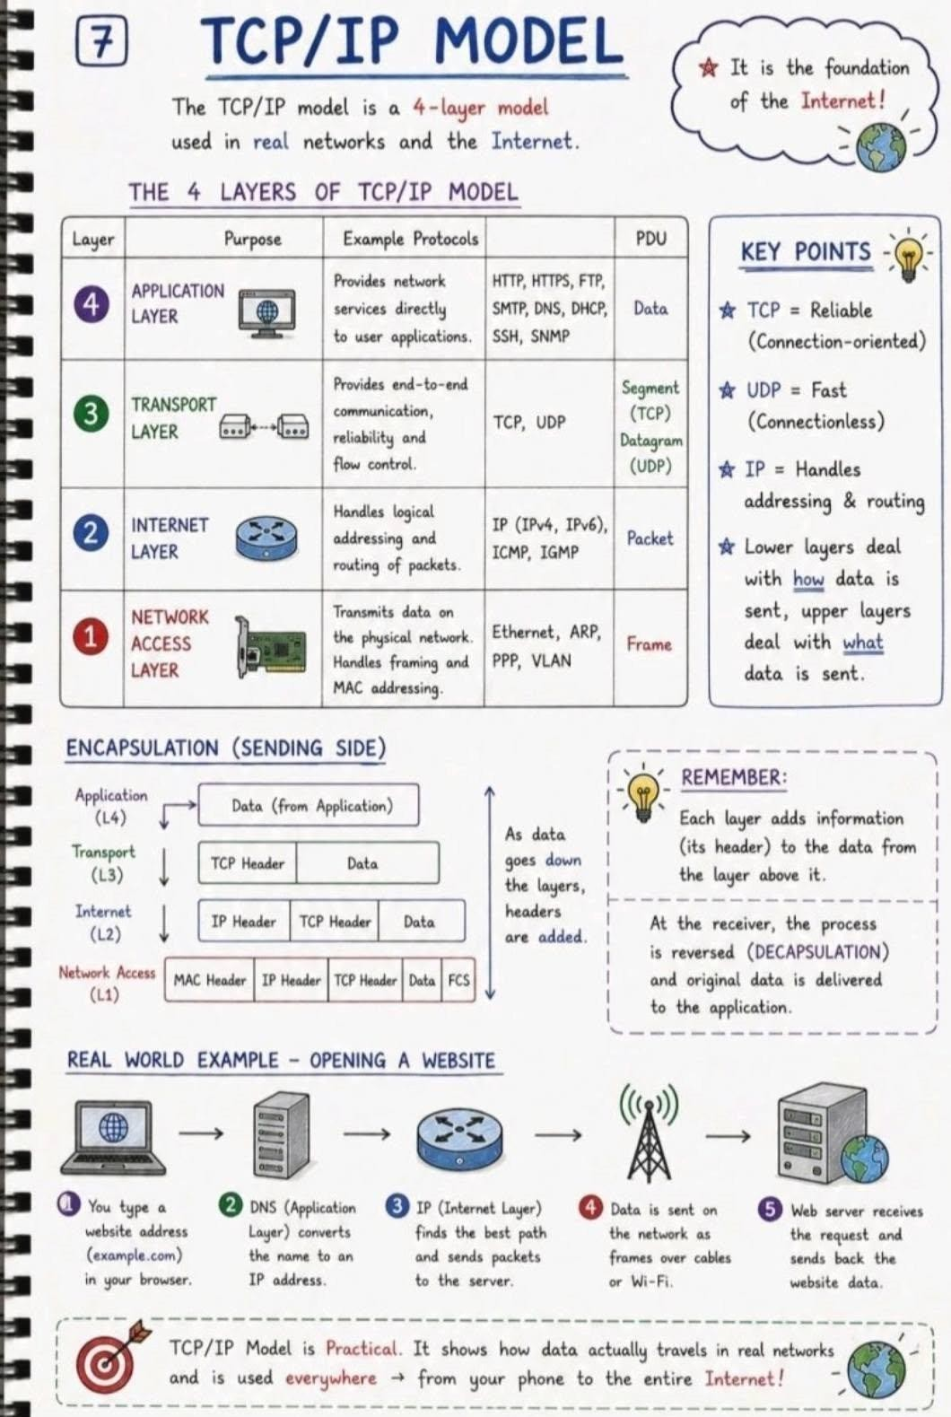
Networking & Connected Technologies

Slide 8
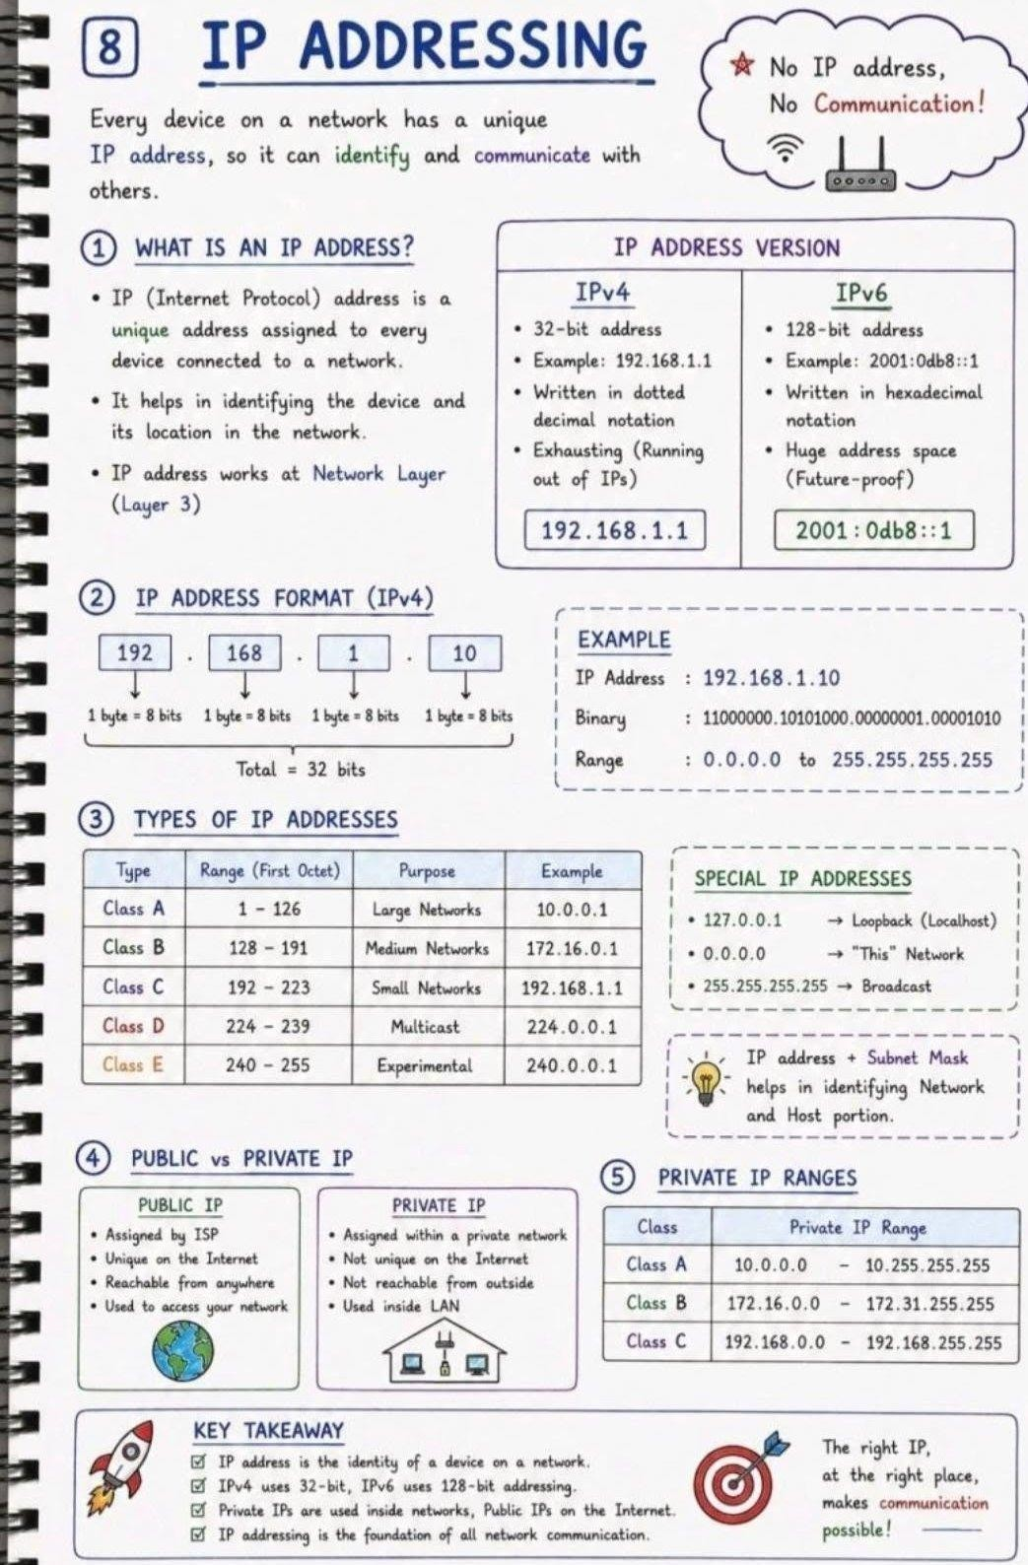
Networking & Connected Technologies

Slide 9
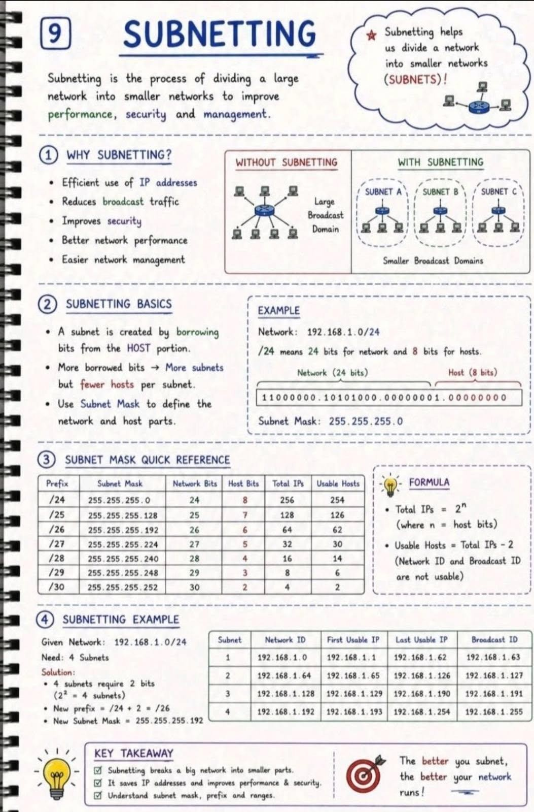
Networking & Connected Technologies

Slide 10
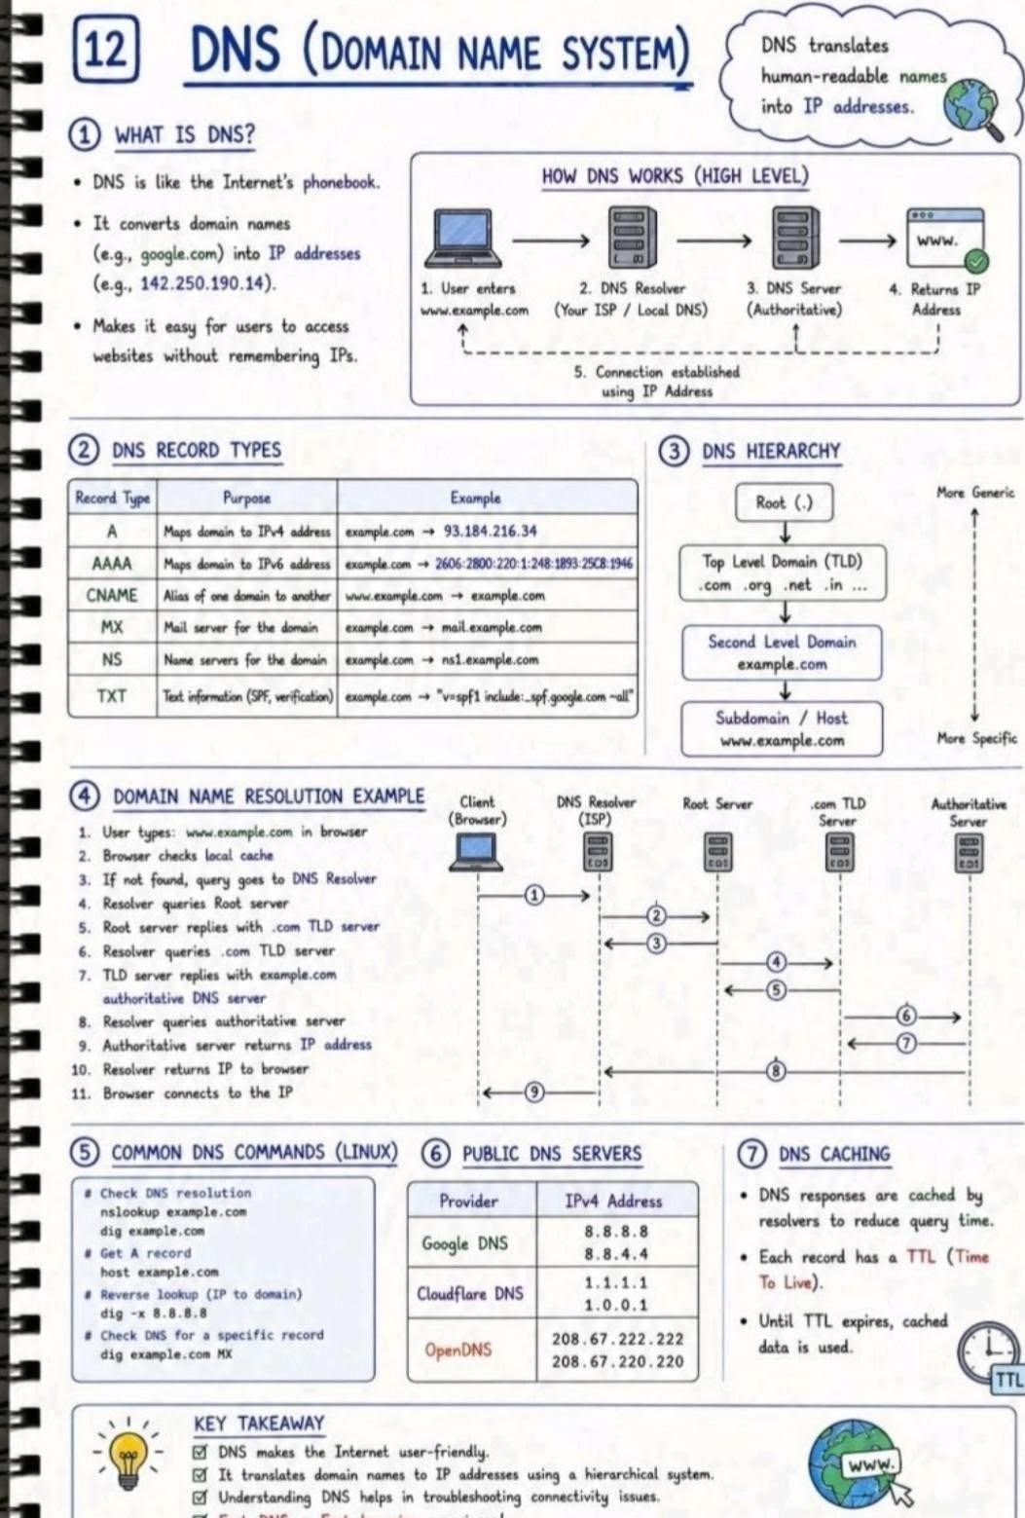
Networking & Connected Technologies

Slide 11
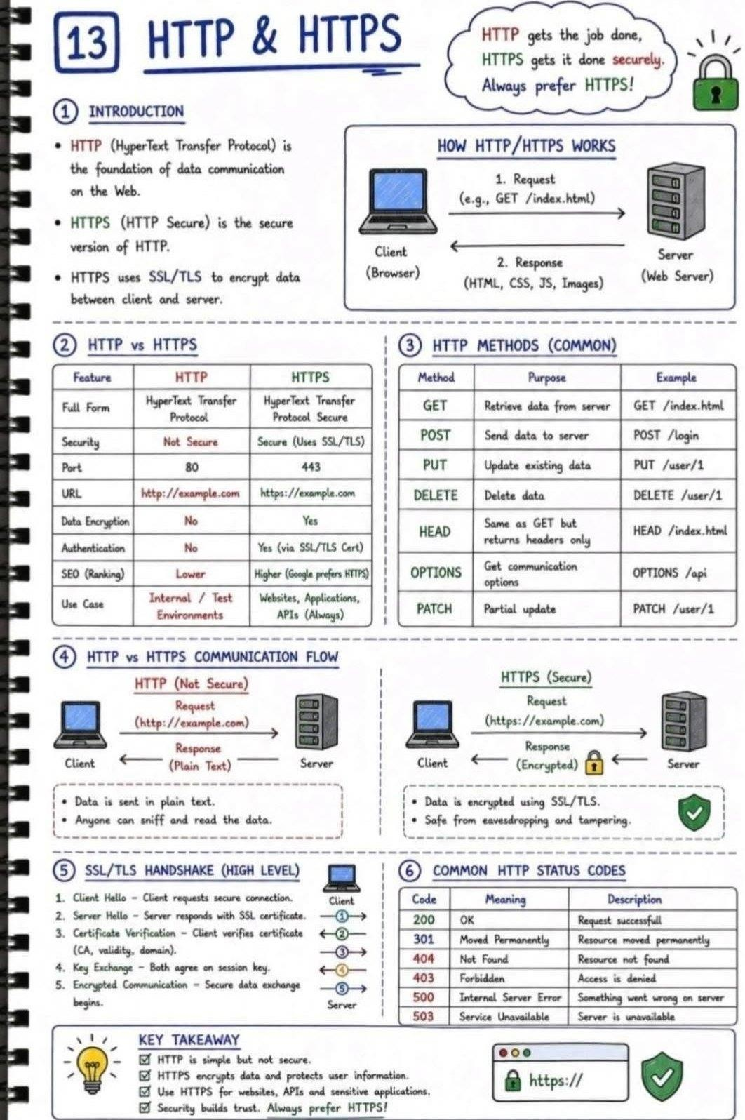
Networking & Connected Technologies

